Slide 1
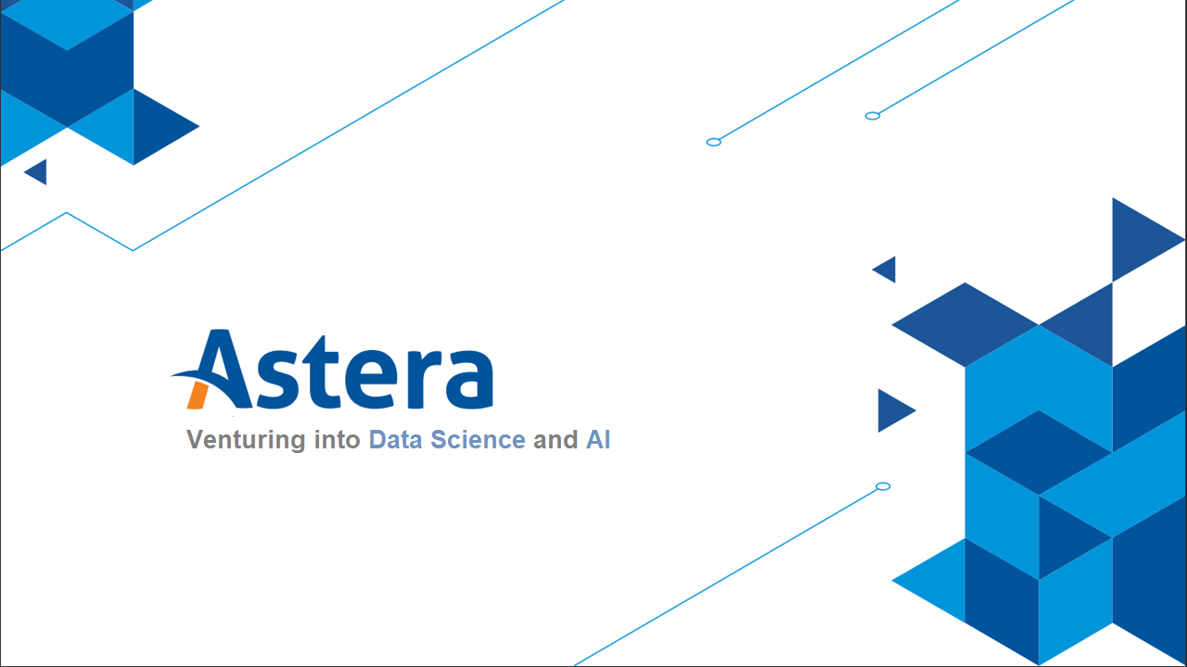

Slide 2
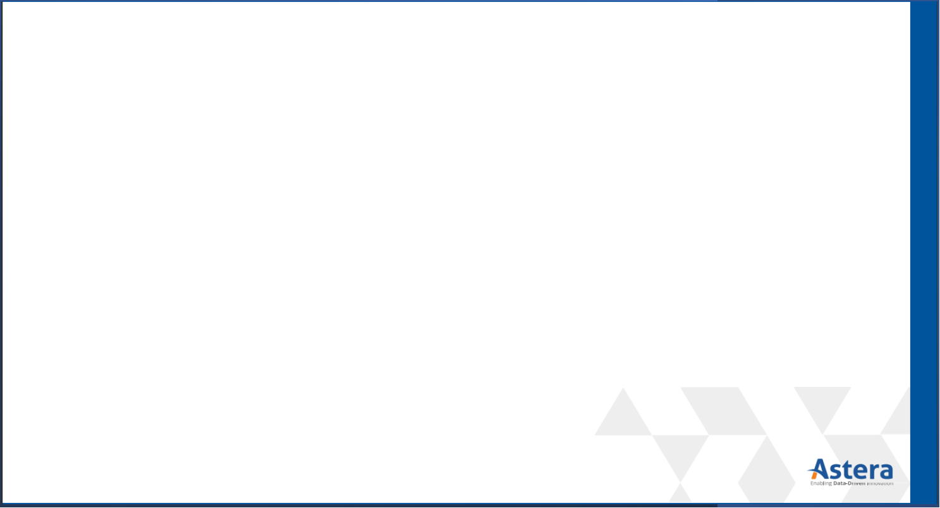
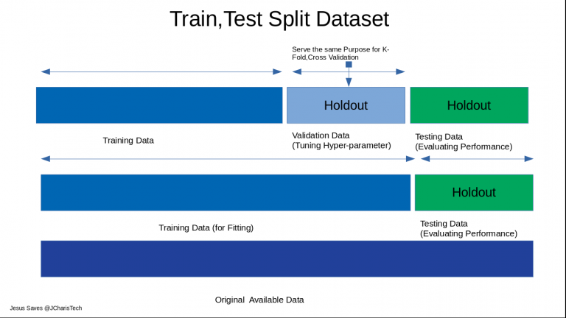
Test/Train Split (Recap)

Slide 3
Topics
Overfitting & Underfitting
Bias-Variance Trade off
Regularized Regression
Industrial Practices for using Regression Model

Slide 4
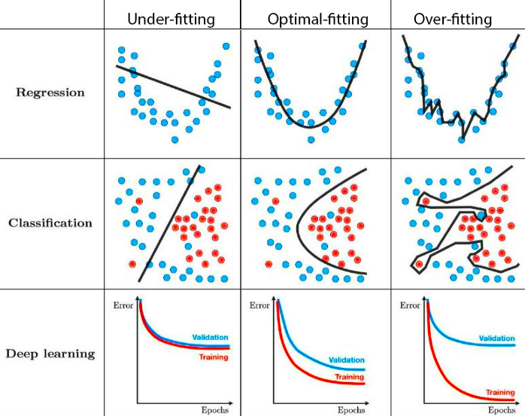
Overfitting & Underfitting
Underfitting refers to a model that can neither model the training data nor generalizes to new data.
Overfitting refers to a model that models the training data too well.
Notes:
The challenge is to select a model that is not too simplistic in terms of excluding important parameters (the model is under-fit), nor overly complex thereby modeling random noise (the model is over-fit)

Slide 5
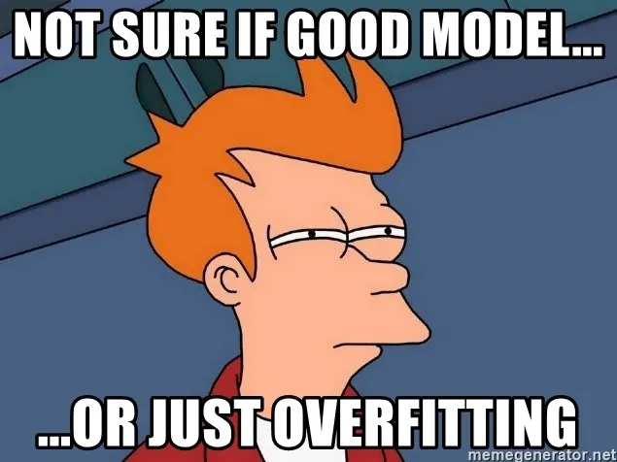
So, who is the best performer among them?
Notes:
With overfit, the performance matrices will give excellent values on train data, but very poor values on test data and the predictions will be way off.
Question for the audience:
1. What would be the behavior of the performance matrices when

Slide 6
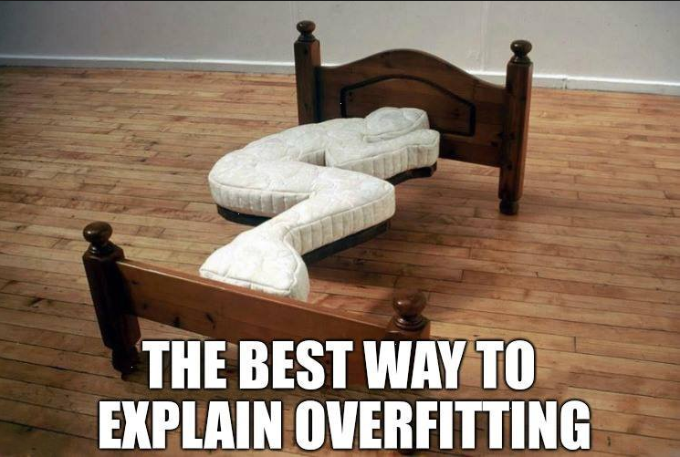
Overfitting:

Slide 7
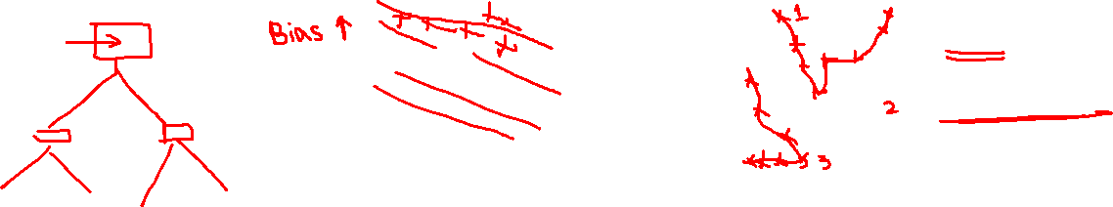
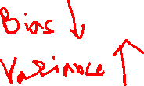
Overfitting & Underfitting
Notes:
Models will perform poorly with unseen data in overfit models.
Performance is consistently bad in seen and unseen data in underfit models

Slide 8
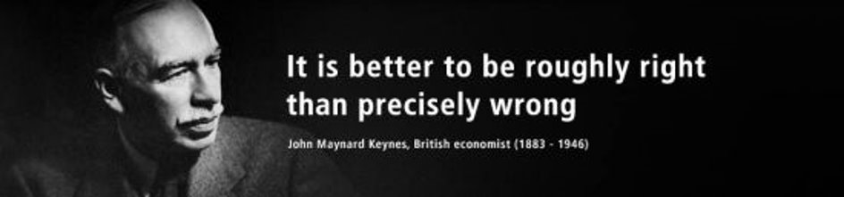
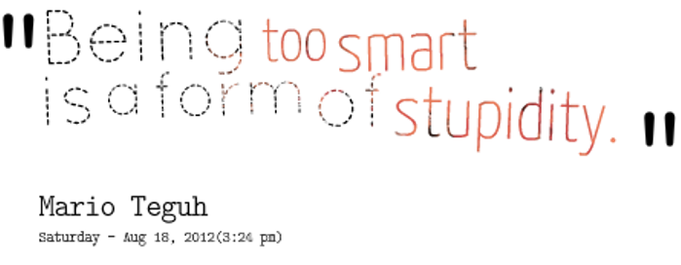
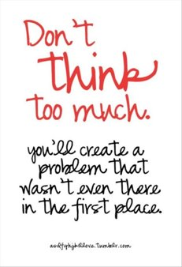
Bias-Variance Tradeoff
Notes:
https://www.youtube.com/watch?v=EuBBz3bI-aA&ab_channel=StatQuestwithJoshStarmer

Slide 9
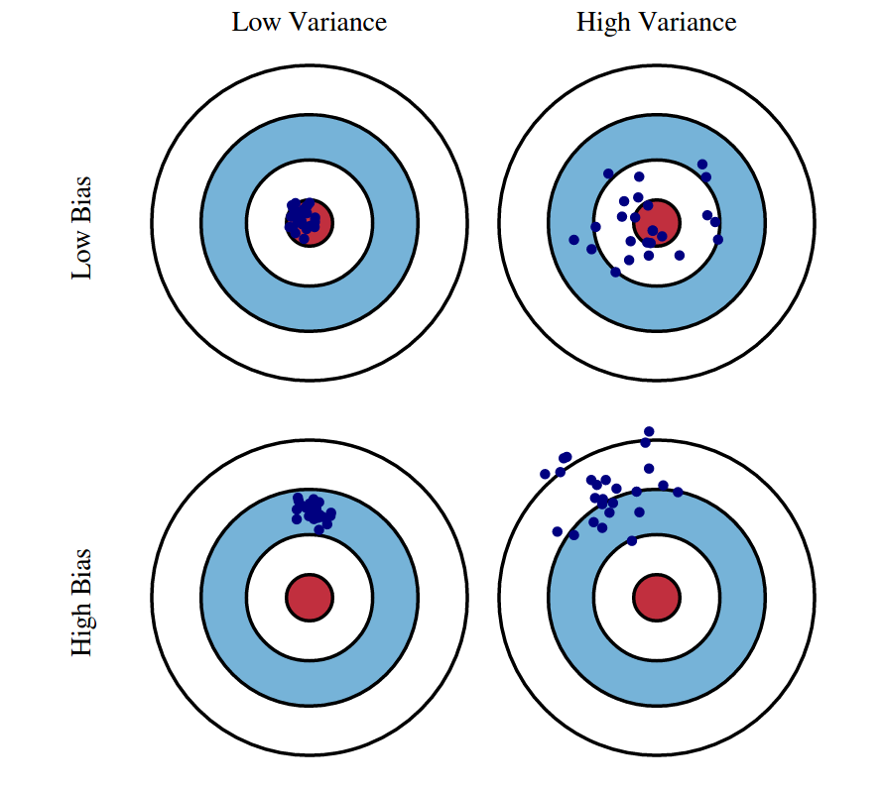
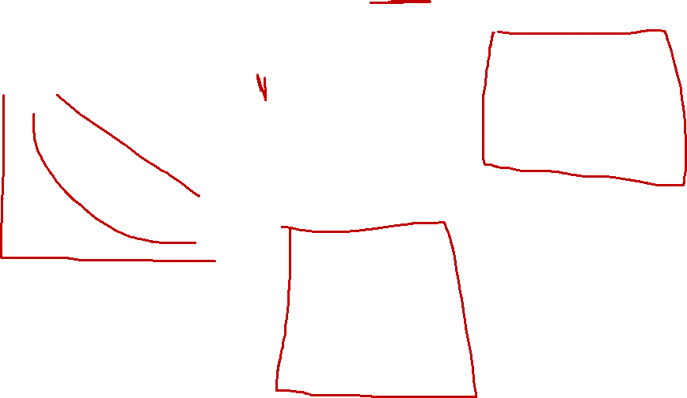
Bias-Variance Tradeoff
Bias is the difference between the average prediction of our model and the correct value which we are trying to predict.
Variance is the variability of model prediction for a given data point or a value which tells us spread of our data
Notes:
Variance refers to the amount by which ^f would change if we estimated it using a different training data set. Different training data sets will result in a different ^f.
Bias refers to the error that is introduced by approximating a real-life problem, which may be extremely complicated, by a much simpler model.

Slide 10
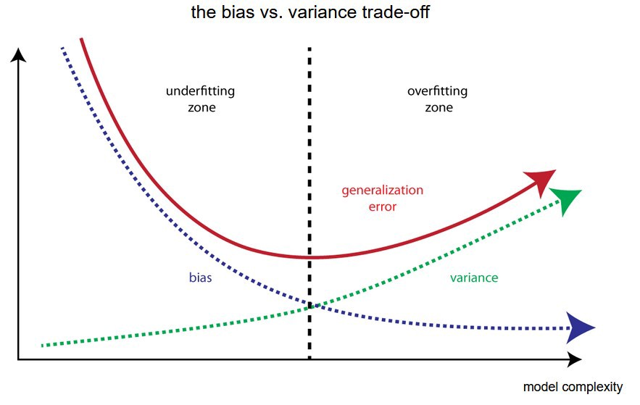
Bias-Variance Tradeoff
Notes:
If our model is too simple and has very few parameters then it may have high bias and low variance. On the other hand if our model has large number of parameters then it’s going to have high variance and low bias. So we need to find the right/good balance without overfitting and underfitting the data.
Underfit >> High bias and low variance (models like LR)
Overfit >> Low bias and High variance (models like decision tree)

Slide 11
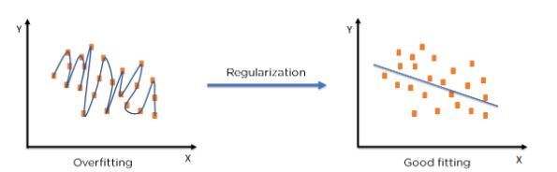
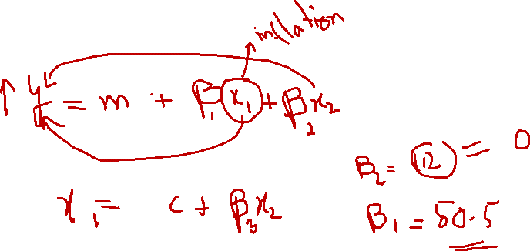
Regularized Regression
“Regularization” is a way to give a penalty to certain models (usually overly complex ones).
Notes:
Also known as shrinkage methods.
we can fit a model containing all p predictors using a technique that constrains or regularizes the coefficient estimates, or equivalently, that shrinks the coefficient estimates towards zero.
It may not be immediately obvious why such a constraint should improve the fit, but it turns out that shrinking the coefficient estimates can significantly reduce their variance. So, what are we dealing with? Overfit or underfit?
L0 Penalty – Removes feature from the model but does not affect other coefficients.
L1 Penalty (Lasso) - Features are reduced equally. Low coefficients are removed.
L2 Penalty (Ridge) - Features are reduced proportionally, with the highest coefficient features reduced the most.
L1 + L2 (Elastic Net) - Combined the removal of low coefficients in lasso and the reduction of high coefficients in ridge

Slide 12
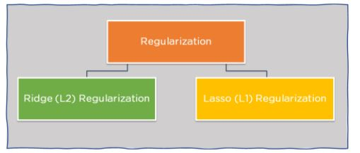
Regularized Regression
There are two main types of regularization techniques: Ridge Regularization and Lasso Regularization.
Notes:
The two best-known techniques for shrinking the regression coefficients towards zero are ridge regression and the lasso.
Number in subscript translates to power of the function
Why regularization?
Reduce features
Minimize effect of high influential features (question of the audience: which other technique can help with this (hint: feature engineering technique)

Slide 13
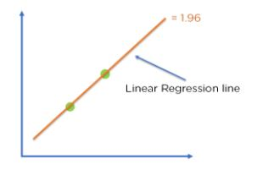
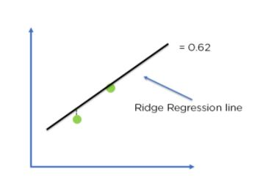
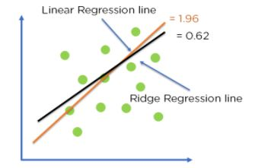
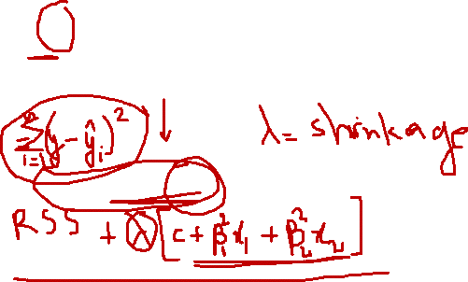
Ridge Regularization (L2)
It modifies the over-fitted or under-fitted models by adding the penalty equivalent to the sum of the squares of the magnitude of coefficients.
Cost Function = Loss + λ x Σw²
Loss = Sum of squared residuals
λ ^{= Penalty for the errors}
^{W = Slope/Weight}
Ridge Regression Model
Optimization of model fit using
Ridge Regression
Linear Regression Model
Notes:
RSS (Residual Sum of Squared) = SSE (Sum of Squared Error)

Slide 14
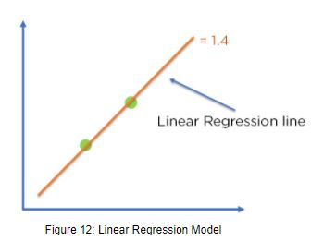
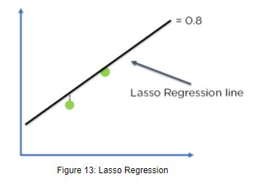
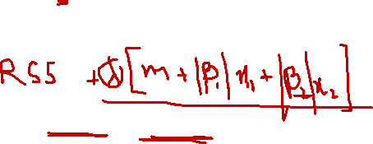
Lasso Regularization (L1)
It modifies the over-fitted or under-fitted models by adding the penalty equivalent to the sum of the absolute values of coefficients.
Cost Function = Loss + λ x Σ|w|
Loss = Sum of squared residuals
λ ^{= Penalty for the errors}
^{W = Slope/Weight}
Lasso Regression Model
Optimization of model fit using
Lasso Regression
Linear Regression Model

Slide 15
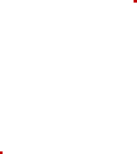
Industrial Practices for using Regression Model
Forecasting Sales: Organizations often use linear regression models to forecast future sales. This can be helpful for things like budgeting and planning.
Predicting Consumer Behavior: Businesses can use linear regression to predict things like how much a customer is likely to spend. Regression models can also be used to predict consumer behavior. This can be helpful for things like targeted marketing and product development.
Cash forecasting: Many businesses use linear regression to forecast how much cash they’ll have on hand in the future. This is important for things like managing expenses and ensuring that there is enough cash on hand to cover unexpected costs.
…

Slide 16

THANK YOU
Training and Certification

